Slide 1
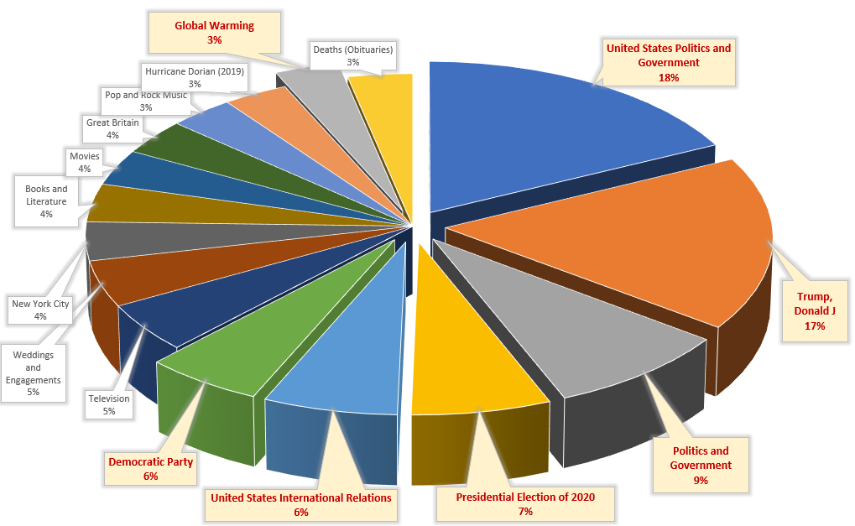
828 Articles extracted for the month of Sept.1 - Oct5.
544 Articles (66%) had 1 or more Keywords
(34%) of Articles used none
544 Articles used 1657 Unique Keywords with a total usage count of 3356
57 Keywords (3.4%) represented 50% of Keywords used
Top 25% of Percent of ALL Keyword usage is Represented by just 16 Keywords
66% of those are about U.S. Politics
Top Keyword Usage by New York Times Authors

